Slide 1
Unlocking the OSEE Core Framework
Roberto Escobar
Boeing
Mesa, AZ

Slide 2
What is OSEE?
OSEE is a tightly integrated environment designed to support lean engineering principles across a product's full life-cycle in the context of an overall systems engineering approach
OSEE has been deployed on Boeing’s next generation Attack Helicopter
  300 users
  Managing ~300,000 Artifacts
  ~250 Active Branches

Slide 3
Objective
Inform developers what the OSEE application framework services offer
For more information http://www.eclipse.org/osee

Slide 4
OSEE Framework Services
Providing the following facilities:
  Transaction-based object-oriented persistence layer
  Dynamic and strongly types artifact model
  Advanced version control including multi-level branching
  Variant management
  Database independent import/export
  Subject-based and object-based access control
  Session management and authentication service
  Multi-client event notification service
  Extensible tagging and searching capabilities
  Task scheduling framework

Slide 5
Network Layout
OSEE Datastore
Remote File
System
Relational Database
OSEE Application Server
192.168.1.100:8090
Ver. 1 & 2
OSEE Application Server
192.168.1.200:8091
Ver. 3
OSEE Application Server
192.168.1.300:8092
Ver. 3
OSEE Arbitration Server
192.168.1.110:8089
OSEE Client
192.168.1.200:8012
Ver. 1
OSEE Client
192.168.1.200:8012
Ver. 2
OSEE Client
192.168.1.200:8012
Ver. 3
Notes:
We decided to use a remote file system for binary data storage – relational database performance was a consideration for the decision.
For this demo we are running all components on the same machine.
We can have each system running on a different PC – including the database and the remote file system
Only restriction is that an application server instance must have access to the data store components.

Slide 6

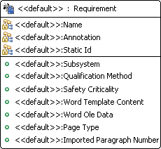
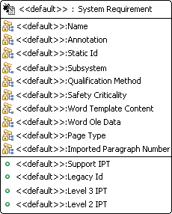
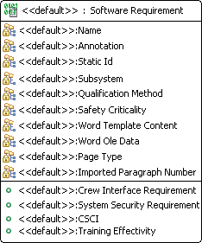
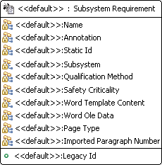
Artifact Types
Inherited Attributes
Inherited Attributes

Slide 7
Artifacts
Simple, User-definable Data Model
Artifact Instance
Software Requirement
Verification Relation
Test Unit
Name: Robot API
Name: Robot API Test
Paragraph Number: 1.1
Source: <Test Code>
Safety Criticality: E
Attribute Instances
Word Content: <……>
Notes:
The main components of the data model are:
Artifact – data objects
Attribute – state data on artifacts
Relations – Link artifacts to one another
All data types are strongly type and user definable

Slide 8
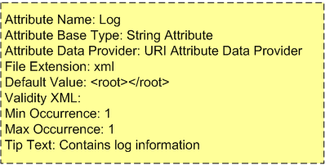
Attribute
Application Server
Application
String Attribute
Base Type
To/From Datastore
Name
Data
URI Attribute
Data Provider
Log
<root>
<log…>
</root>
Attribute Instance
Attribute Type

Slide 9
Transactions and Branches
System Root Branch
Project 1 Branch
3
Changes committed in transaction 4
Time
4
Relation Changed
Transactions
Deleted Requirement
5

Slide 10
Variant Management
Commit into parent with no conflicts
Conflicts resolved in a merge branch before commit
Working Branch A
Program A
Update Program B with latest changes from Program A
Working Branch B
Merge Branch A
Program B
Product B.3 (Product B w/ Additions)
Time

Slide 11
Example
Aircraft Maintenance Log Book
  Stores multi-program historical flight information
  Uses authentication and access control
  Using Artifact search API to easily access data
  Easily pluggable with Eclipse plug-ins
    For example - using BIRT to chart flight performance indicators
  Flight data analysis

Slide 12
Questions?

